Slide 1
Monitoring and Observability in Spring Integration
Anju munoth

Slide 2
Monitoring
Monitoring is the practice of watching a system using a predefined set of metrics and alerts.
Know what you want to watch ahead of time — CPU usage, error rate, queue depth — and you set up dashboards and thresholds for those known quantities.
Monitoring answers the question: "Is the system healthy right now?"
Monitoring is like checking your car's dashboard gauges.

Slide 3
Observability
Observability is a broader property of a system.
A system is observable if you can understand its internal state purely from its external outputs — without needing to deploy new code or add new instrumentation.
Answers questions you didn't think to ask beforehand: "Why is this one user experiencing slow responses on Tuesday afternoons?"
Observability is like having a mechanic who can diagnose any problem just by listening to the engine, reading the exhaust, and checking the oil — even a problem the car manufacturer never anticipated.

Slide 4
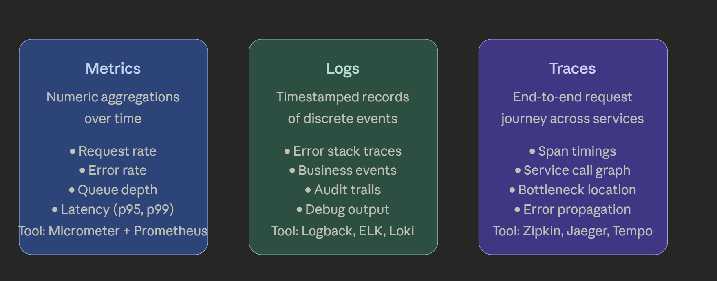
Three Pillars of Observability
Metrics tell you something is wrong · Logs tell you what happened · Traces tell you where

Slide 5
Three Pillars of Observability
Metrics tell you something is wrong · Logs tell you what happened · Traces tell you where
three pillars complement each other and are used together in practice.
Metrics alert you that something is wrong.
Then jump to logs to find the specific event.
Traces let you follow that event across every service it touched.

Slide 6
Why Observability Matters Especially for Spring Integration
Spring Integration apps are built around asynchronous message flows — messages pass through channels, transformers, routers, and handlers.
Creates a unique challenge: a single logical business operation might touch 6 different components, cross 3 thread boundaries, and fail silently inside a handler.
Without observability, you are essentially flying blind.
Concretely, the things you need to answer in a Spring Integration app are:
Performance questions — which channel is the bottleneck? Which handler has the highest p99 latency? Is my poller keeping up with inbound message rate?
Reliability questions — how many messages are failing and at which handler? Is my dead-letter channel growing? Are retries working?
Capacity questions — is my queue depth trending upward? Am I approaching thread pool saturation?
None of these questions can be answered by looking at a single component in isolation. You need the whole picture.

Slide 7
Instrumentation
Monitoring is reactive and predefined.
Set up an alert for "error rate > 5%" and get paged when it fires.
Know what to watch for.
Observability is proactive and exploratory.
When something unexpected happens — say, one specific message type is taking 10x longer than others only for orders over $500 — you can investigate that without deploying new code, because your system already emits enough data to reconstruct what happened.
The goal when instrumenting a Spring Integration app with Micrometer and Prometheus is to move toward the observability end of that spectrum — collecting rich, tagged, high-cardinality data so that you can answer questions you haven't thought of yet.

Slide 8
Prometheus plays the role of a time-series metrics storage and alerting system.
Spring Integration exposes metrics (message counts, channel throughput, handler latency) and Prometheus scrapes them from a /actuator/prometheus endpoint on a schedule.
It's the backend store, not the collection layer.
Micrometer is the collection layer —
Vendor-neutral metrics facade that sits inside your application, instruments your code, and speaks to many backends including Prometheus.
Think of Micrometer as SLF4J but for metrics.

Slide 9
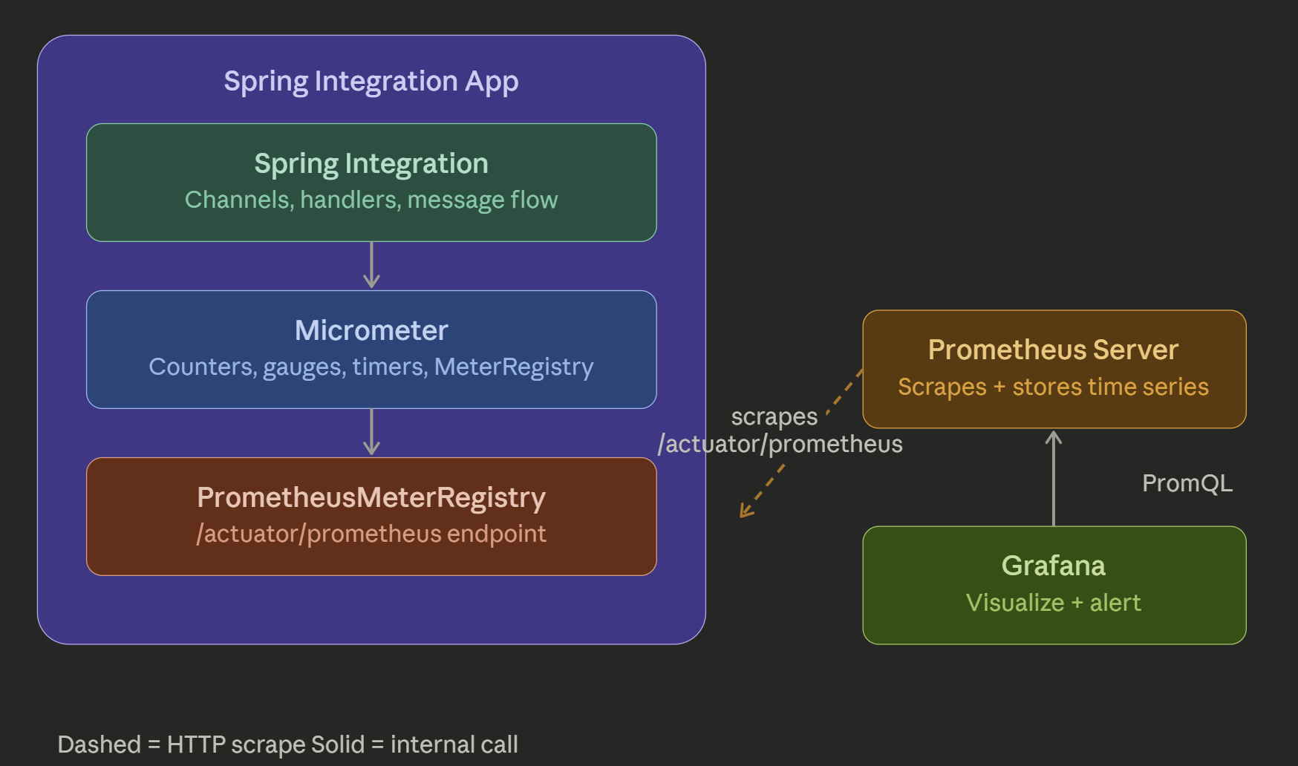

Slide 10
Micrometer --Core concepts
Micrometer organizes everything around a MeterRegistry.
Every meter (Counter, Gauge, Timer, etc.) is registered in it.
With Spring Boot, a registry is auto-configured when you add the right dependency.

Slide 11
Four fundamental meter types
Meter | What it measures | Example
Counter | A value that only goes up | Messages sent
Gauge | A value that goes up and down | Queue depth
Timer | Latency + throughput together | Handler execution time
DistributionSummary | Arbitrary value distribution | Message payload size

Slide 12
Maven dependencies
<!-- Spring Boot Actuator (brings Micrometer core) -->
<dependency>
<groupId>org.springframework.boot</groupId>
<artifactId>spring-boot-starter-actuator</artifactId>
</dependency>
<!-- Prometheus registry -->
<dependency>
<groupId>io.micrometer</groupId>
<artifactId>micrometer-registry-prometheus</artifactId>
</dependency>
<!-- Spring Integration (auto-registers SI metrics) -->
<dependency>
<groupId>org.springframework.integration</groupId>
<artifactId>spring-integration-core</artifactId>
</dependency>

Slide 13
application.yml
management:
endpoints:
web:
exposure:
include: health, info, prometheus, metrics
metrics:
export:
prometheus:
enabled: true
endpoint:
prometheus:
enabled: true

Slide 14
@Service
public class OrderProcessingService {
private final Counter orderCounter;
private final Counter orderErrorCounter;
// Micrometer's fluent builder injects MeterRegistry
public OrderProcessingService(MeterRegistry registry) {
this.orderCounter = Counter.builder("orders.processed")
.description("Total orders processed successfully")
.tag("service", "order-processing") // tags become Prometheus labels
.tag("region", "us-east")
.register(registry);
this.orderErrorCounter = Counter.builder("orders.errors")
.description("Total order processing errors")
.tag("service", "order-processing")
.register(registry);
}
public void processOrder(Order order) {
try { // your business logic
performProcessing(order);
orderCounter.increment(); // increment by 1
} catch (Exception e) {
orderErrorCounter.increment(); throw e; }
}
}
What this produces in Prometheus format at `/actuator/prometheus`:
orders_processed_total{service="order-processing",region="us-east"} 142.0
orders_errors_total{service="order-processing"} 3.0

Slide 15
Timer — measure latency
Timer is Micrometer's most powerful type.
Records both duration and call count in a single meter.

Slide 16
// Style 1: wrap a lambda (simplest)
public Message<?> transform(Message<?> message) {
return transformationTimer.record(() -> doTransform(message));
}
// Style 2: manual start/stop (useful when you need the result AND timing)
public Message<?> transformWithSample(Message<?> message) {
Timer.Sample sample = Timer.start(registry); // capture start time
try {
Message<?> result = doTransform(message);
sample.stop(transformationTimer); // stop and record
return result;
} catch (Exception e) {
// Tag dynamically on error — note: this creates a new timer series
Timer.builder("si.message.transformation")
.tag("channel", "orderChannel")
.tag("exception", e.getClass().getSimpleName())
.register(registry)
.record(Duration.ZERO);
sample.stop(transformationTimer);
throw e;
}
}

Slide 17
@Component
public class MessageTransformationHandler {
private final Timer transformationTimer;
private final MeterRegistry registry;
public MessageTransformationHandler(MeterRegistry registry) {
this.registry = registry;
this.transformationTimer = Timer.builder("si.message.transformation")
.description("Time taken to transform messages")
.tag("channel", "orderChannel")
.publishPercentiles(0.5, 0.95, 0.99) // p50, p95, p99 latency
.publishPercentileHistogram() // enables Prometheus histogram
.sla( // SLA violation tracking
Duration.ofMillis(100),
Duration.ofMillis(500)
)
.register(registry);
}
// Style 1: wrap a lambda (simplest) or style 2 manual start/stop
private Message<?> doTransform(Message<?> message)
{ // actual transformation logic return message; }
}

Slide 18
```
Prometheus output:
```
si_message_transformation_seconds_count{channel="orderChannel"} 500
si_message_transformation_seconds_sum{channel="orderChannel"} 12.34
si_message_transformation_seconds_max{channel="orderChannel"} 0.482
si_message_transformation_seconds{channel="orderChannel", quantile="0.5"} 0.018
si_message_transformation_seconds{channel="orderChannel", quantile="0.95"} 0.214
si_message_transformation_seconds{channel="orderChannel", quantile="0.99"} 0.441

Slide 19
Gauge — snapshot values
A Gauge observes an existing value on demand.
Bind it to a supplier function, not a recorded value.
unlike Counter and Timer, a Gauge holds a weak reference to its object.
If your supplier object gets garbage collected, the gauge silently disappears.
Always store a strong reference.

Slide 20
@Component
public class IntegrationChannelMetrics {
// Suppose you track a queue manually
private final AtomicInteger queueDepth = new AtomicInteger(0);
public IntegrationChannelMetrics(MeterRegistry registry) {
// Bind to an AtomicInteger directly
Gauge.builder("si.channel.queue.depth", queueDepth, AtomicInteger::get)
.description("Current depth of the order message queue")
.tag("channel", "orderInputChannel")
.register(registry);
// Or bind to any object with a supplier
Gauge.builder("jvm.custom.thread.active", this,
obj -> Thread.activeCount())
.description("Currently active threads")
.register(registry);
}
public void messageReceived() { queueDepth.incrementAndGet(); }
public void messageConsumed() { queueDepth.decrementAndGet(); }
}

Slide 21
Summary
Micrometer talks to PrometheusMeterRegistry (which formats data in Prometheus exposition format),
Prometheus scrapes your app on a schedule,
Grafana queries Prometheus with PromQL.
Spring Integration adds a layer on top of all this by auto-registering meters for every channel and handler — so you get a baseline of metrics without writing a single instrumentation line.

